Slide 1



Becoming Good Stewards of Antibiotics Protocol Overview & Microbiology 101
Peter P. Patterson MD

Slide 2
“Stewardship”
Stewardship: becoming “good stewards”
Caring for a valued/critical resource
Taking action to protect antibiotics
Preserving antibiotic effectiveness
Restoring antibiotic effectiveness
Antibiotics are unique – a shared resource
Antibiotic use in one patient affects all patients around facility

Slide 3
Stewardship Protocol – Main Ideas
Root cause of widespread antibiotic resistance:
Overuse of antibiotics (→ alter testing and prescribing habits)
Syndrome-focused testing & prescribing audit
Initial syndromes are “UTI” and “PNA”
Audit of facility testing & prescribing combines data from multiple sources:
Lab, pharmacy, radiology, clinical features
Feedback in a structured communication loop
RedCAP data collection tool
Regular reports to prescribers and nursing staff
1. CDC. The Core Elements of Antibiotic Stewardship for Nursing Homes. 2015.
Available at: http://www.cdc.gov/longtermcare/index.html

Slide 4
Stewardship Protocol – Main Ideas (cont.)
Alternatives to “just-in-case” antibiotic use
Observation pathway – push fluids and monitor
In-service education – start-up and periodic
Admin’s, prescribers, all staff, IP nurse and patients
1. CDC. The Core Elements of Antibiotic Stewardship for Nursing Homes. 2015.
Available at: http://www.cdc.gov/longtermcare/index.html

Slide 5
Top Metrics to Track
# urine cultures (C&S)
# positive urine cultures (C&S)
# chest x-rays (CXRs) done
#positive chest x-ray reports
# cases receiving antibiotic Rx
# cases meeting uniform case definition
# Days-of-therapy (uDOT, rDOT)

Slide 6
Microbiology 101– Principles
Principle #1
Just because a bug is growing in your resident, does not necessarily mean it’s causing infection … ?colonization vs. ?infection
“Tending the Body’s Microbial garden”: The New York Times – September 2012 “Germs Are Us”: The New Yorker – October 2012

Slide 7
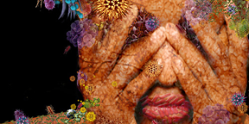
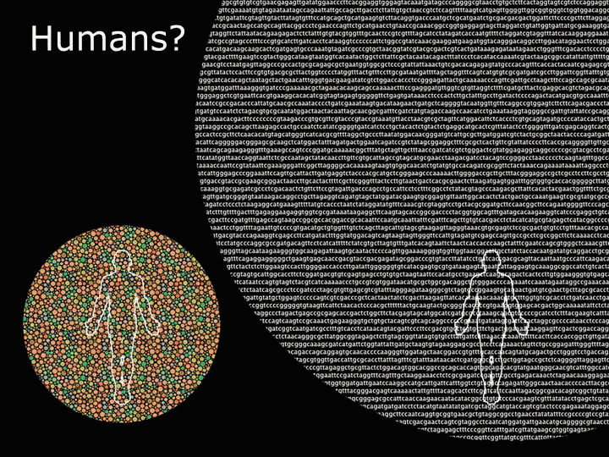
Principles(cont.) – Our Microbial Garden
Bacteria are ubiquitous … and … invisible
The human microbiome … is more diverse than the human genome.
Our bodies have 10x non-human cells vs. human cells.
1,000,000+ genes vs. 23,000 genes
Human Genome Project
Human Microbiome Project

Slide 8

Our Microbial Garden (cont.)
The “original” germ theory (1800 – 2000)
Bacteria make us sick … cause disease … are dangerous
“Pathogens” cause specific diseases
Ideal is germ-free/super-clean surroundings
Problem/issue is “contamination”
“the only good bug … is a dead one”

Slide 9
Our Microbial Garden (cont.)
The “new” germ theory (2000 – 2200 :-)
Bacteria were here 400 million years before humans and are mutual partners with all animal species
Partnership is a complex regulatory balance
Immune system’s main function is to manage relationships with our resident bacteria/viruses
Bacteria sometimes make us sick … … but they also keep us alive
Gut bacteria are essential to immune system and food digestion
“You’re only as healthy as your gut flora”

Slide 10
Microbiology 101 Principles (cont.)
Principle #2 – There Are Two Kinds of Cultures
From normally sterile sites (e.g. blood, csf, joint)
E. coli bacteremia/septicemia (blood)
E. coli meningitis (csf)
E. coli septic arthritis (joint)
From sites with normal flora e.g. urine, wound/skin, throat
An organism growing here may be (only) colonizing
E. coli pharyngitis??
To distinguish colonization from infection we need a “significance test” (colony count, gram stain)

Slide 11
Urine “Significance Test”: Colony Count
Clean-voided urine (nearly) always contains organisms washed out from the anterior urethra.
The colony count is used to adjust for urethral contamination.
Colony counts >100,000 organisms/ml are more likely to be predictive of a UTI.
Colony counts <10,000 organisms/ml most likely represent contaminating organisms from the urethra.
Colony counts 25,000 or 50,000 organisms/ml?
Asymptomatic bacteriuria
“Our current paradigm of ‘UTI’ is deeply flawed” Dr. John Finucane (Am J Med 2016)

Slide 12

Microbiology 101 – Practices
Standardized criteria for C&S interpretation (Urine C&S and UTI diagnosis)
“S” is for Symptoms

Slide 13
Case Definition – UTI
Positive urine culture:
At least 100,000 cfu/ml of one organism
Positive UTI clinical picture:
At least one of the following … a. new acute dysuria b. fever OR leucocytosis AND one of: 1. acute CVA pain or tenderness 2. suprapubic pain 3. gross hematuria 4. new or marked increase in incontinence/urgency/frequency c. IF absence of fever or leucocytosis THEN two (2) or more of 1-4 above.
Modified from McGeer Criteria rev. 2012

Slide 14
Case Definition – Pneumonia
Positive Chest Xray report:
“ … new infiltrate …pneumonia …”
Positive pneumonia clinical picture:
Either of the following … a. Leucocytosis OR fever AND one of: 1. new or increased cough 2. new or increased purulent sputum 3. hypoxemia (sat. <94% on air or >3% on O₂) 4. respiratory rate >25/min 5. new or changed lung exam findings 6. pleuritic chest pain b. IF absence of leucocytosis or fever THEN two (2) or more of 1-6 above.

Slide 15
Clinical Opportunity
“Stewardship” – being good stewards
Preserving antibiotic effectiveness
Restoring antibiotic effectiveness
Improved patient care
Decreased complications (C. difficile disease)

Slide 16
Summary points
Antibiotic stewardship goals:
To measure antibiotic prescribing
To make visible antibiotic overuse
To minimize misdiagnosis of asymptomatic bacteriuria and other non-infections
To enhance decision-making: prescribers/nurses
Steer a transition in thinking (mindset)
Diagnostic stewardship goals
Decrease unnecessary urine cultures
Decrease unnecessary chest x-rays

Slide 17
Summary Points
Asymptomatic bacteriuria should not be treated
Treating asymptomatic bacteriuria as an infection only contributes to multiple drug resistance when the patient gets a real infection … and initiates the vicious cycle of antibiotic whack-a-mole … and opens the door to post-antibiotic complications

